Slide 1
Lesson 4
Resolution in Remote Sensing

Slide 2
We have Learnt:
Definition of Remote sensing
Planck’s law of radiation
Peak emitted wavelength from sun and earth .
Electromagnetic radiation or wave
Advantages of remote sensing
Classification of Remote sensing: Based on spectral region
and based on technique
Spectral Signature of vegetation, water and soil
Panchromatic/multispectral/ Hyper
spectral remote sensing

Slide 3
Resolution in Remote sensing
Ability to distinguish smallest feature in
remote sensing image
Human eyes? .02 mm

Slide 4
DETECTION OF FEATURES depends: RESOLUTION
THERE ARE FOUR RESOLUTIONS IN REMOTE SNSING
Spatial resolution (what details)
Spectral resolution ( What colour and band)
Radiometric resolution ( no. of bits)
Temporal resolution ( Time interval between successive observations)

Slide 5
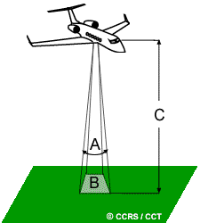
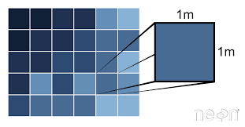
Spatial resolution and coverage
Spatial resolution
Instantaneous field-of-view (IFOV)
Pixel: smallest unit of an image
Pixel size
Spatial coverage
Field of view (FOV), or
Area of coverage or swath
B
In practice, objects 0.04mm wide (the width of a fine human hair) are just
distinguishable by good eyes, objects 0.02mm wide are not.
Pixel size ranges from 1.1 microns in the smallest smartphone sensor, to 8.4 microns in
a Full-Frame sensor.

Slide 6
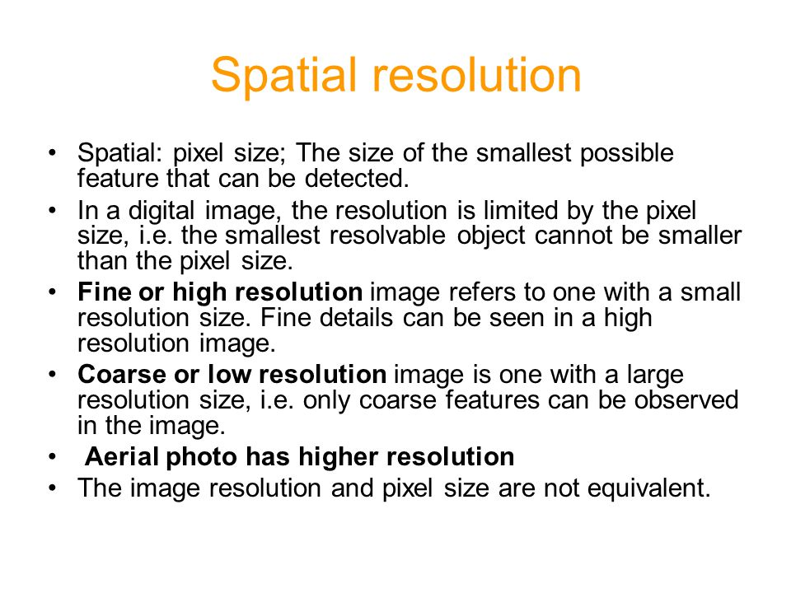

Slide 7
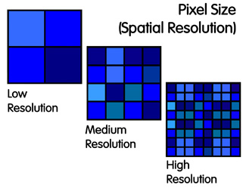

Slide 8
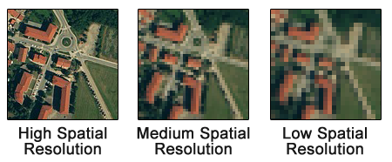

Slide 9
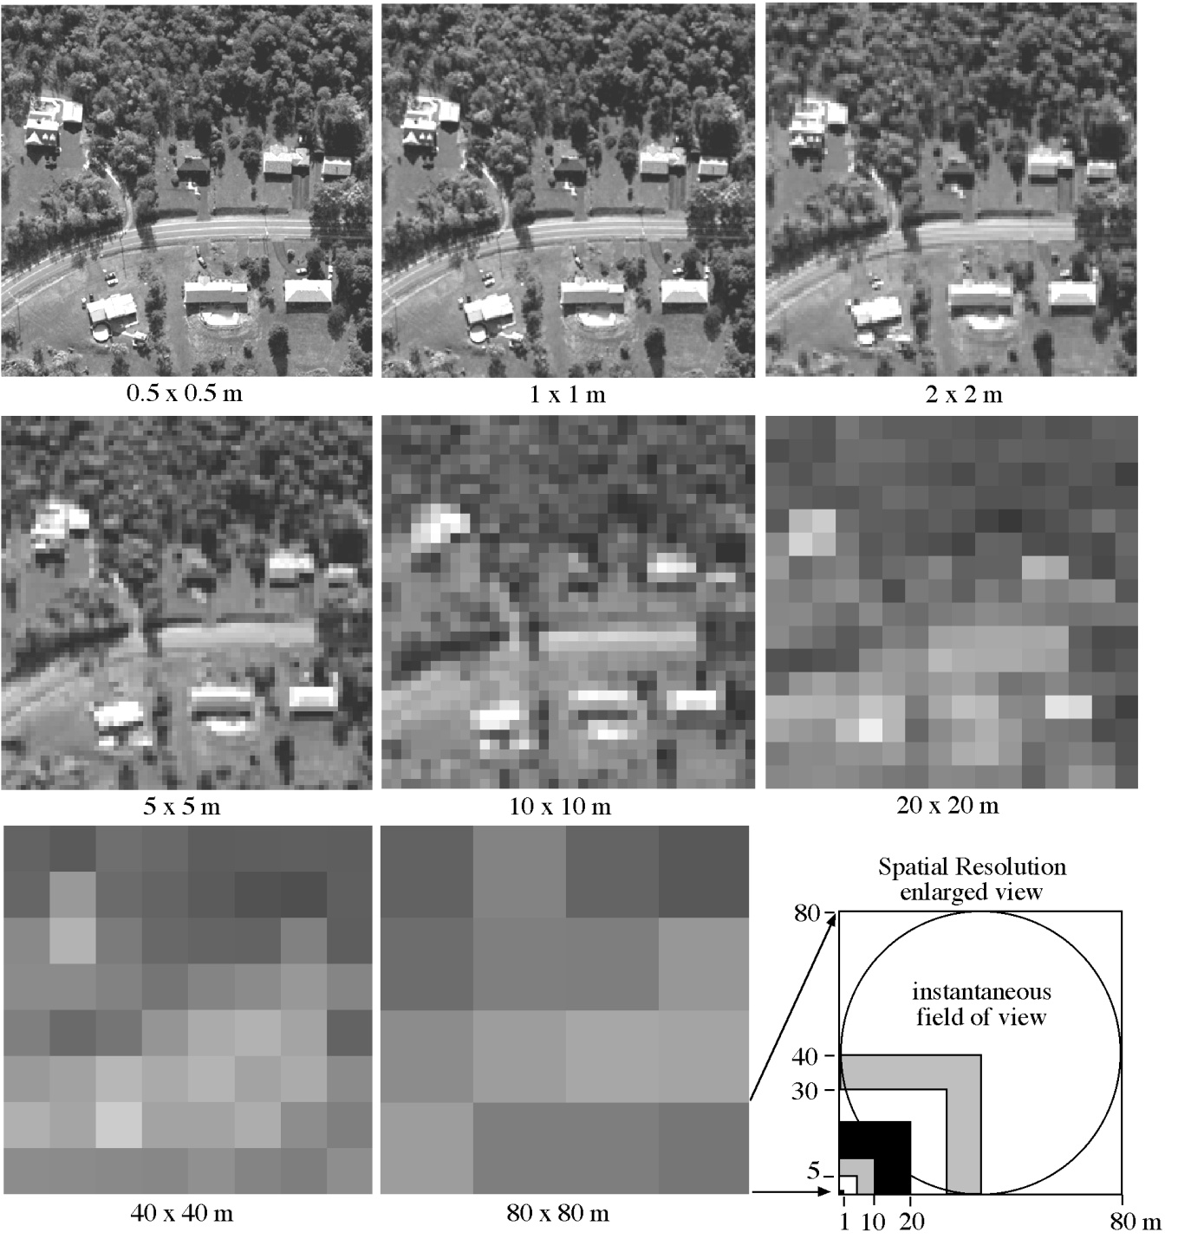
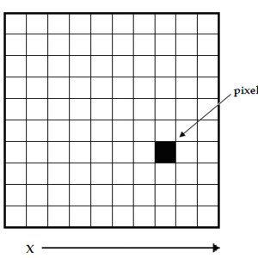
Spatial Resolution
29 microns.
= .003 mm
Jensen, 2000

Slide 10
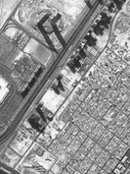




Object identification depending upon pixel size
10m pixel
original image
1m pixel 2m pixel 5m pixel
30m pixel →

Slide 11
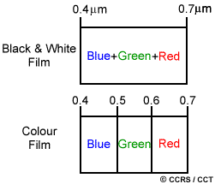
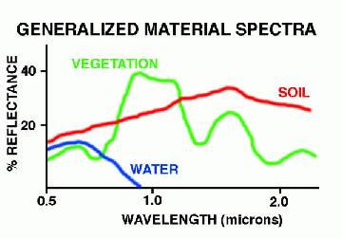
Spectral resolution (Δλ ) and coverage (λ_{min} to λ_{max})
Spectral resolution describes the ability of a sensor to define fine wavelength intervals
The finer the spectral resolution, the narrower the wavelength range for a particular channel or band

Slide 12
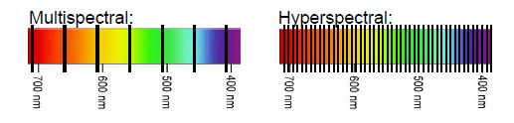
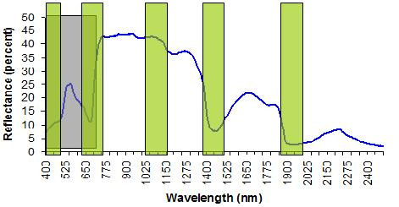

Slide 13
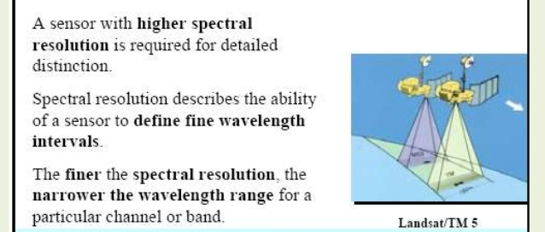

Slide 14
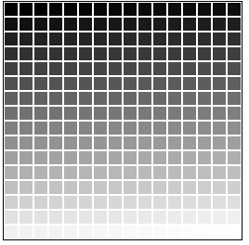
Radiometric resolution and coverage
Sensor’s sensitivity to the magnitude of the electromagnetic energy,
Sensor’s ability to discriminate very slight differences in (reflected or emitted) energy,
The finer the radiometric resolution of a sensor, the more sensitive it is to detecting small differences in energy

Slide 15
What is GREYSCALE/ GREYLEVEL?
Grayscale is a range of shades of gray without apparent color. The darkest possible shade is black, which is the total absence of transmitted or reflected light.
The lightest possible shade is white, the total transmission or reflection of light at all visible wavelength s. Intermediate shades of gray are represented by equal brightness levels of the three primary colors (red, green and blue) for transmitted light, or equal amounts of the three primary pigments (cyan, magenta and yellow) for reflected light.
Gray level resolution refers to the predictable or deterministic change in the shades or levels of gray in an image.

Slide 16
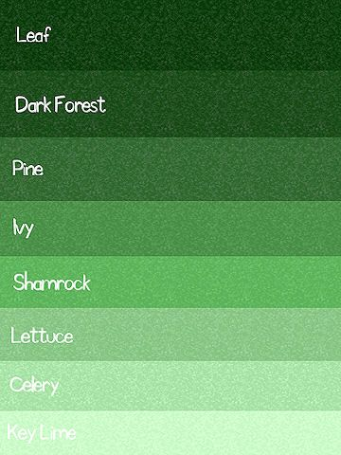
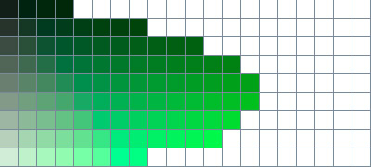
A healthy human eye has three types of cone cells, each of which can register about 100 different colour shades.

Slide 17
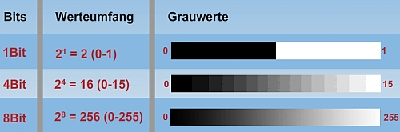
The radiometric resolution of image data in remote sensing stands for the ability of the sensor to distinguish different grey-scale values. It is measured in bit. The more bit an image has, the more grey-scale values can be stored, and, thus, more differences in the reflection on the land surfaces can be spotted.
Range of numbers that sensor uses for recording reflected light => Quantisation level

Slide 18
Basics of Bit
bits | Max. num
1 | 2
2 | 4
3 | 8
6 | 64
8 | 256
11 | 2048
12 | 4096
Computer store everything in 0 or 1
(2^{bits})
Bit no.
7 | 6 | 5 | 4 | 3 | 2 | 1 | 0
0 | 0 | 0 | 0 | 0 | 0 | 0 | 0
1 | 1 | 1 | 1 | 1 | 1 | 1 | 1
0
256
8 bits as an example
Resolution: 12 bits
Coverage: 0 - 4095

Slide 19
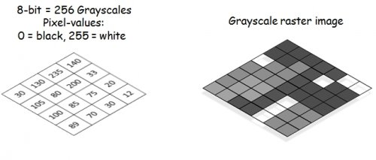

Slide 20
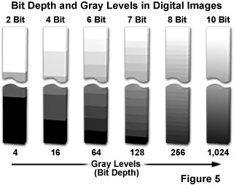
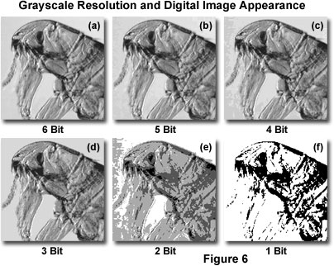

Slide 21
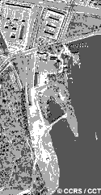
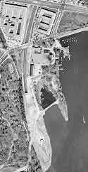
Comparing a 2-bit image with an 8-bit image

Slide 22
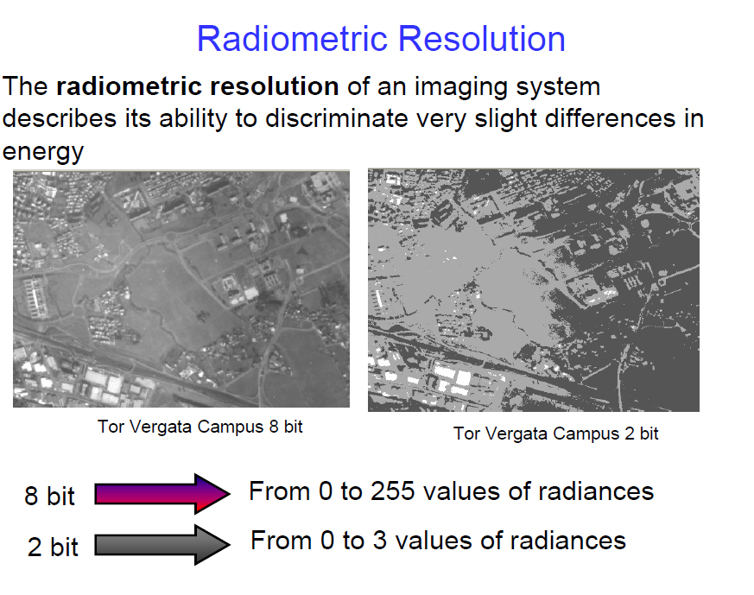

Slide 23
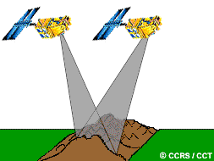
Temporal resolution and coverage
Temporal resolution is the revisit period, and is the length of time for a satellite to complete one entire orbit cycle, i.e. start and back to the exact same area at the same viewing angle. For example, Landsat needs 16 days, MODIS needs one day,.
Temporal coverage is the time period of sensor from starting to ending.

Slide 24
Temporal Resolution
July 2
July 18
August 3
16 days
Time
11 days
July 1
July 12
July 23
August 3

Slide 25
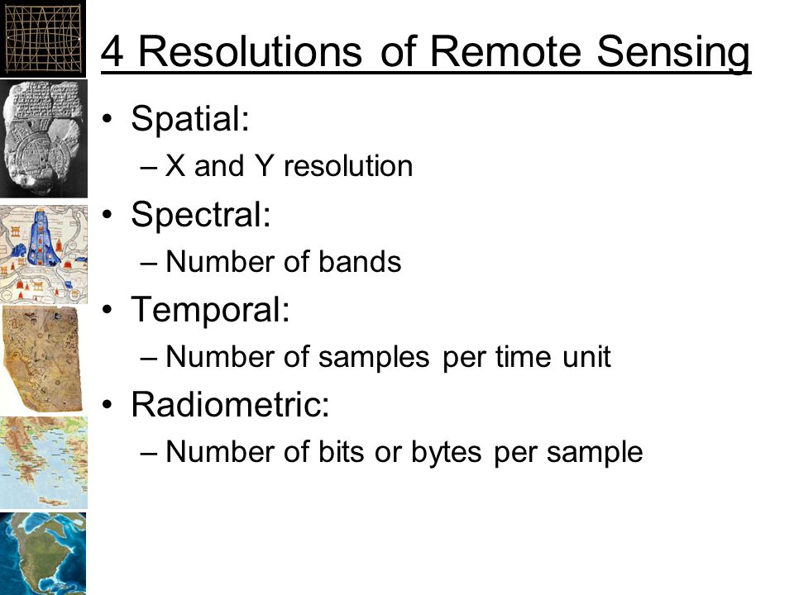

Slide 26
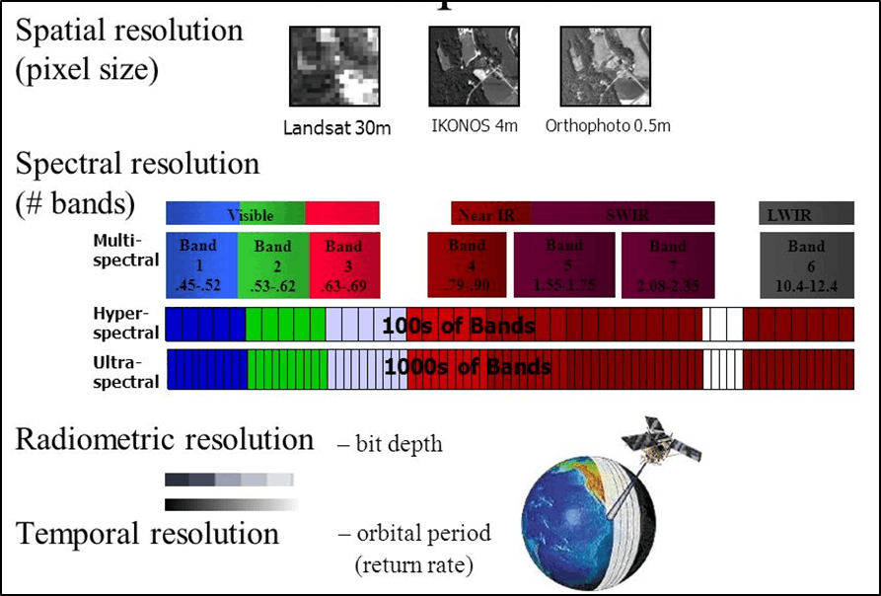
SUMMARY

Slide 27
Question bank
Explain:
Spectral resolution
Spatial resolution
Radiometric resolution
Temporal Resolution

